Slide 1
Washing Machine CU
Name: Kerellos Nashaat Naguib.
Faculty : Faculty of Engineering EECE, Cairo University.
Graduation year: 2023.
Presented in Fulfillment of the Requirements for Mixel’s ASIC intern application

Slide 2
TABLE OF CONTENTS
01
02
Requirements of the design
Top Architecture of the design
03
04
Modules detailed explanation
Testbench and Test cases
Control unit, Clock divider and Timer functionality and code explaination

Slide 3
01
Requirements of the design

Slide 4
Requirements of the design
It’s required to design a washing machine control unit, which operates as FSM that contains 5 states “Idle, Filling Water, Washing, Rinsing, Spinning” Where each state has its own duration in minutes. So We need a timer module.
It’s required for the operating frequency that it has 4 possible values encoded by clk_freq[1:0]. So We need a clock divider module.
It’s required to have a double wash input signal to have a second wash and rinse, and also it’s required a timer pause input signal to have the timer pauses only in the spinning state and hence the machine stops spinning.
So, from these requirements lets take a look on the top architecture of our design

Slide 5
02
Top Architecture of the design

Slide 6
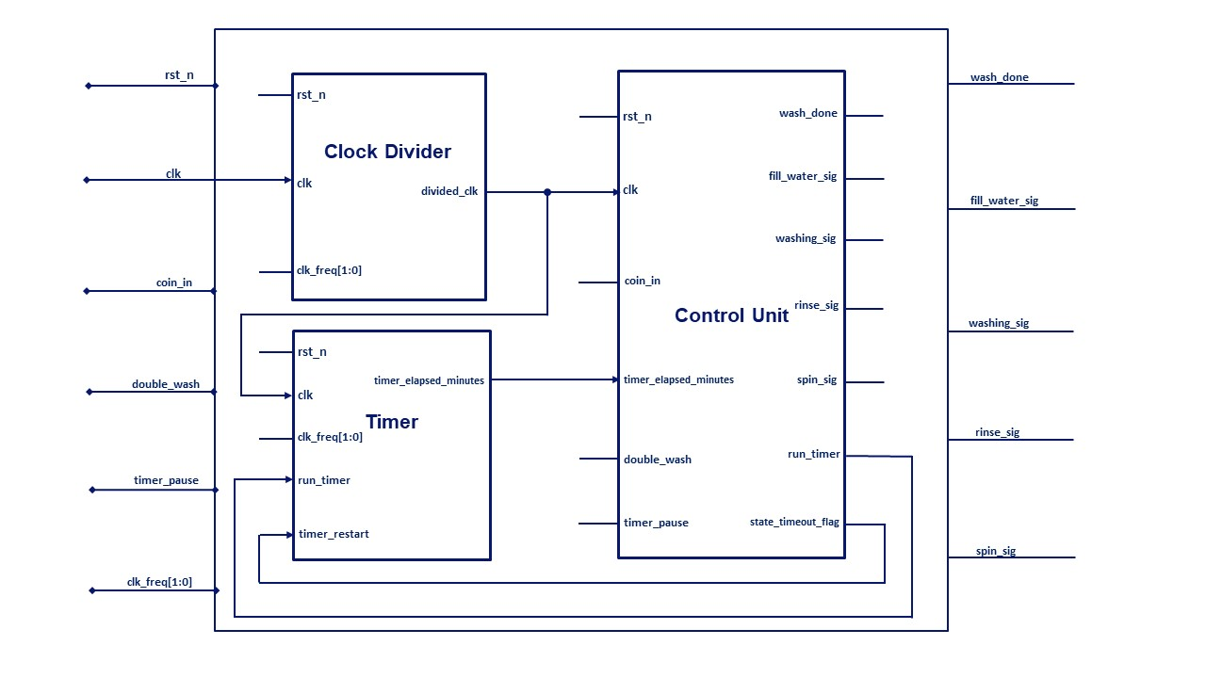
Top Architecture of the design

Slide 7
Top Architecture of the design
It’s Noticed from the previous diagram :
We added some extra outputs : to facilitate testing the functionality like the “fill_water_signal” which is an output that indicates that the control unit entered the Filling water state, and also can be used in real life to signal another external device or external unit to start filling water.
We added also internal signals for the interfacing between the three blocks and each other.
Our goal in the design is to make a modular architecture that achieves the required functionality with complete synthesizable code, free of inferred latches and combinational loops.

Slide 8
03
Modules detailed explanation
Control unit, Clock divider and Timer functionality and code explanation

Slide 9
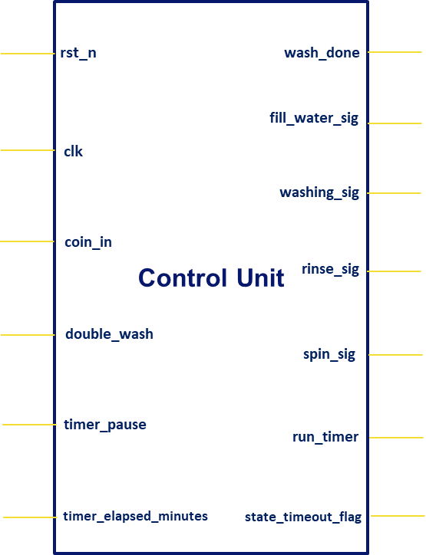
Modules detailed explanation
Control Unit
Firstly, We will talk about the washing machine contol unit.
Input ports :
- rst_n : The Asynchronous Reset.
- clk : It’s coming from the clock divider. *
- coin_in : It signals the machine to start.
- double_wash : a second wash and rinse to occur.
- timer_pause : if high and the FSM is in the
spinning state, timer pauses “run_timer = 0”,
and spinning stops “spin_sig = 0”. *
- timer_elapsed_minutes[2:0] : It’s coming from the
timer and it tells the control unit the time elapsed
in minutes measured from the beginning of a state,
in order that the CU knows when the duration
of this state ends so it can go to the next state. *
[2:0]

Slide 10
Modules detailed explanation
Control Unit
Output ports :
- wash_done : indicates the all states are finished,
So the machine as returned to ideal state after
the spinning phase is done and deasserted when
coin_in is set to ‘1’
- The four signals : fill_water_sig, washing_sig,
rinse_sig and spin_sig indicate that the FSM
entered their corresponding states and also can be used
in real life to signal another external device or external unit
to execute their indented job. *
The Following two signals are control signals to the timer
- run_timer : it runs the timer if high, and pauses it if low. *
- state_timeout_flag : This signal restarts the timer when
the current state duration is elapsed, in order to start to
count over again for the new state. *
[2:0]

Slide 11
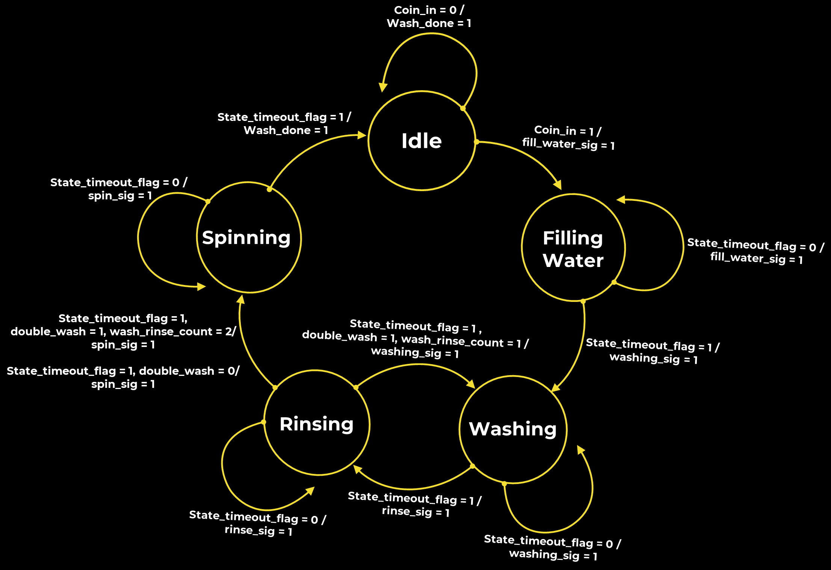
Modules detailed explanation
Control Unit
Functionality : mealy FSM
[2:0]

Slide 12
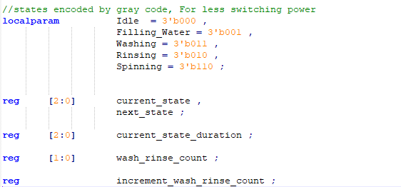
Modules detailed explanation
Control Unit
Code and Explaination
Internal signals and FSM encoding
[2:0]

Slide 13
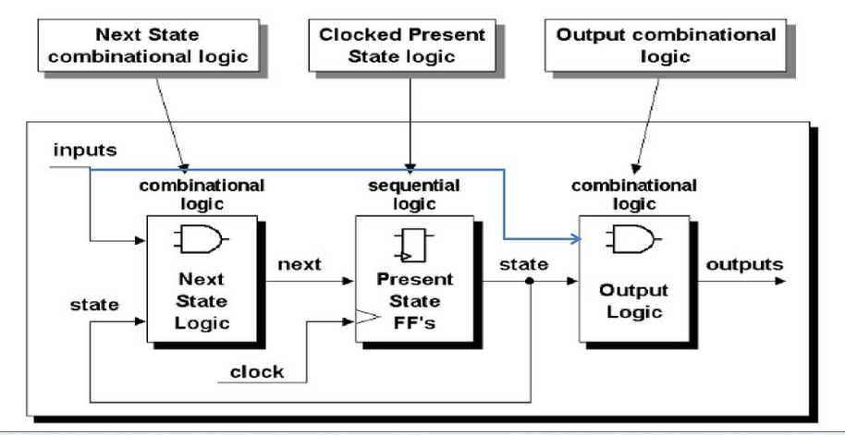
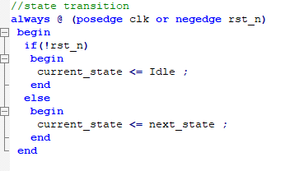
Modules detailed explanation
Control Unit
Code and Explaination
We wrote the FSM in the form of
three always blocks, one of them is
a sequential always for the state
transition and the rest of the two
are combinational always for the
logic that compute the next state
and the logic which compute the
output
[2:0]

Slide 14
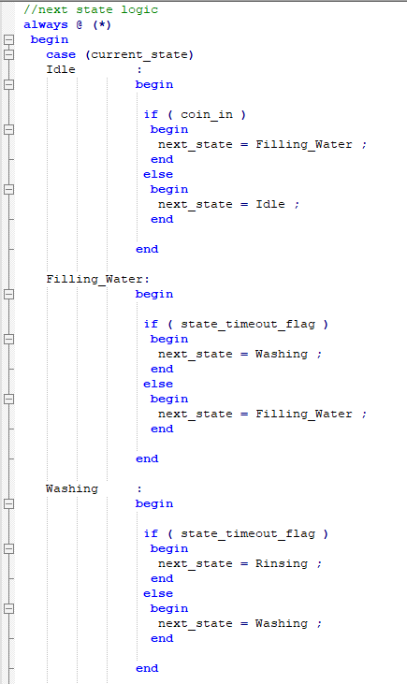
Modules detailed explanation
Control Unit
Code and Explaination
Next state logic is fully explained the previous
State diagram
[2:0]

Slide 15
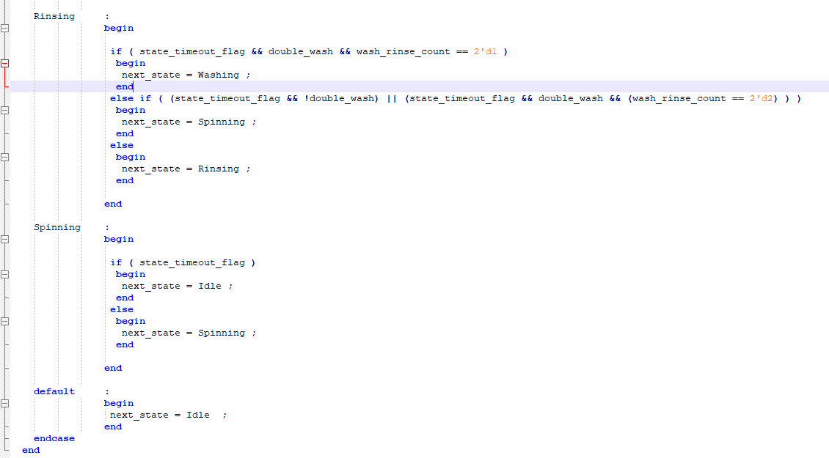
Modules detailed explanation
Control Unit
Code and Explaination
The rest of the always block that
Compute the next state
[2:0]

Slide 16
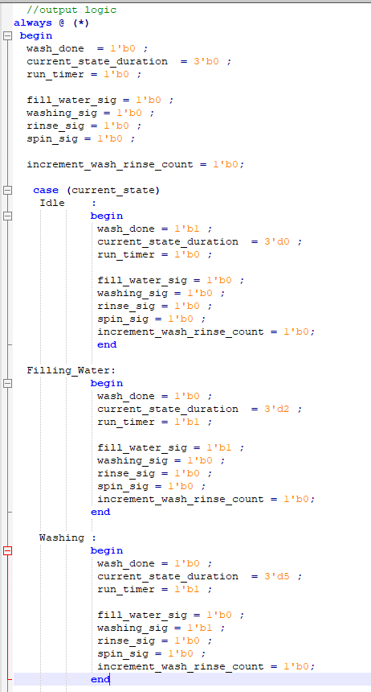
Modules detailed explanation
Control Unit
Code and Explaination
The combinational always block that Compute
the output
The initial values are put, to ensure there’s no incomplete
assignment of signal in any of the case and hence no
inferred latch.
Note : the signal “current_state_duration” is assigned is each state with the state duration, For example it’ assigned with 2 at the filling water state and
it’s assigned with 5 at the washing state.
This signal “current_state_duration” is then Compared with the time coming from the timer to know when the current state duration will end so the FSM can move to the next state. This comparison is done through the following
assign statement
Initial Values
[2:0]

Slide 17
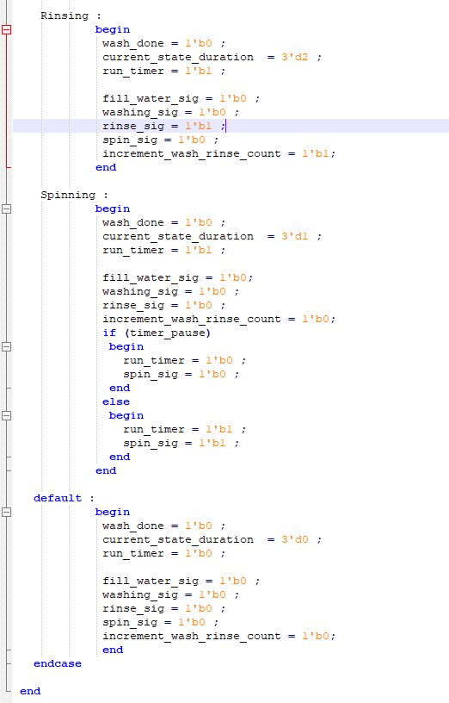
Modules detailed explanation
Control Unit
Code and Explaination
The rest of combinational always block that Compute
the output
Please Note : The timer_pause signal is used only in the Spinning state, So it has no effect on anything on the other state.
When timer_pause is high in the spinning state, the run_timer signal goes low “So the timer stops” and also the spin_sig goes low “So the machine stops spinning”
After the timer_pause signal becomes low again, the run_timer signal goes high “So the timer resumes” and also the spin_sig goes high again “So the machine resumes the spinning”
Initial Values
Condition on Timer_pause
[2:0]

Slide 18
Modules detailed explanation
Control Unit
Code and Explaination
The rest of combinational always block that Compute
the output
Note : we saw ealier from the state diagram, and the always block that compute the next state that the next state computation inside the rinse state depends on the number of wash rinse cycles done, as in case of double wash after the first wash rinse cycles (i.e. if the wash_rinse_count == 1) , the FSM goes back to washing state to perform the second wash rinse cycle, and after it does so (i.e. if the wash_rinse_count == 2), this time it moves from the rinse state to the spin state. So we need a counter the counts the wash rinse cycle done. this signal “increment_wash_rinse_count” is used to trigger a counter
that increments every time the FSM enter the rinse state
but resets when the wash is done (wash_done = 1 ).
This Counter is implementation is in the next slide.
Initial Values
[2:0]

Slide 19
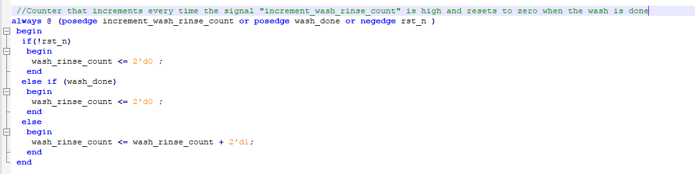
Modules detailed explanation
Control Unit
Code and Explaination
The Implementation of the wash rinse cycle counter.
The counter is triggered by the increment_wash_rinse_count which is set to one at the rinse state.
This counter resets for every wash done.
This counter count up to 2 in case of the double wash and we use its stored value to decide on the next state in case of the rinse state.
Initial Values
[2:0]

Slide 20
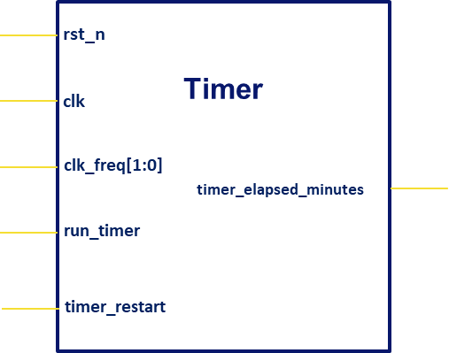
Modules detailed explanation
Timer
Secondly, We will talk about the Timer.
Input ports :
- rst_n : The Asynchronous Reset.
- clk : It’s coming from the clock divider. *
- clk_freq[1:0] : It informs the timer about which
frequency is input to it from the clock divider.
- run_timer : it’s a control signal coming from the
control unit and it runs the timer if high, and
pauses it if low.
- timer_restart “synchronous reset” : it’s a control
signal coming from the control unit and it
restarts the Timer when a state duration is
finished so the timer counts over again for the
new state duration.
In other word “timer_restart = synchronous reset”
[2:0]

Slide 21
Modules detailed explanation
Timer
Output ports :
- timer_elapsed_minutes[2:0] : This signal is fed
into the control unit and it tells the control unit
the time elapsed in minutes measured from the
beginning of a state, in order that the CU knows
when the duration of this state ends so it can go
to the next state. *
[2:0]

Slide 22
Modules detailed explanation
Timer
Functionality :
We will implement the timer as a counter that increments every positive edge.
So for the timer to count up to one second time, the number of counts = the input clock frequency to the timer (example if the frequency is 1 MHz, the timer has to count 1000 000 counts “which represents the delay of 1000 000* clk period” for the 1 second to elapse).
[2:0]

Slide 23
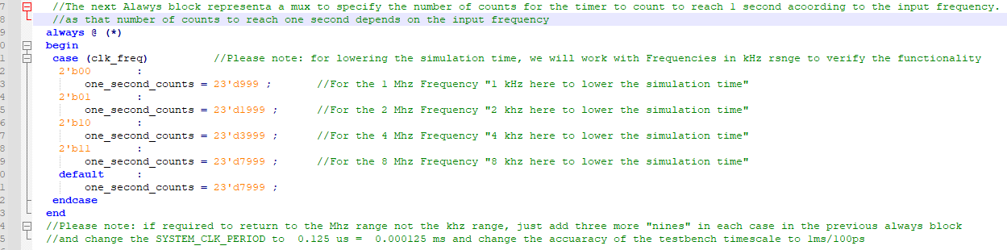
Modules detailed explanation
Timer
Code and Explaination
The code will implement the previous functionality “the counter idea” But since we have four possible input frequencies (1 MHz, 2 MHz, 4 MHz , 8 MHz), We defined a signal “one_second_counts” Which is assigned inside a mux by the input clock frequency value In order that if the timer counts up to “one_second_counts” value, we can consider 1 sec elapses.
[2:0]

Slide 24
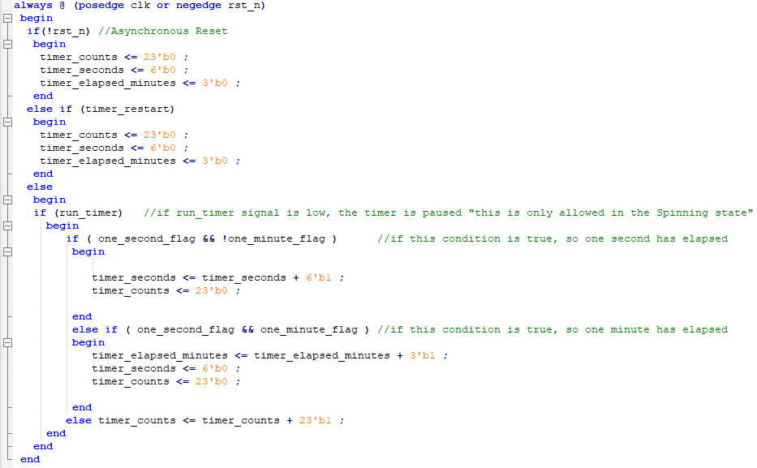
Modules detailed explanation
Timer
Code and Explaination
Counter Implementation
Actually we implemented three counters,
“timer_counts” counter which increments every positive edge “Counts up to 1 sec”
“timer_seconds” which count the seconds and it counts up to 1 min.
“timer_elapsed_minutes” which counts the minutes and it’s input to the Control unit to give it the time info.
According to the below assign statements, when timer_counts reaches one_sec_counts the one_sec_flag is raised which will reset the timer_counts in the next clk, Similarly when
1 min elapses the one_min_flag is raised which will reset the timer_seconds in the next clk.
Else increment timer_counts
[2:0]

Slide 25
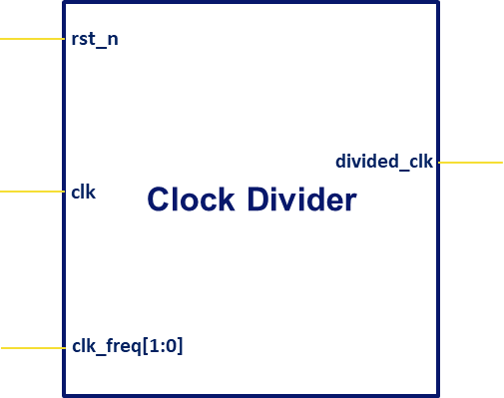
Modules detailed explanation
Clock Divider
Finally, We will talk about the Clock Divider.
Input ports :
- rst_n : The Asynchronous Reset.
- clk : It’s the external input clock and we assumed
it as 8 MHz and we will divide it to get the rest
desired frequencies . *
- clk_freq[1:0] : It selects the output divided clock
frequency from the available frequencies after
division (1 MHz, 2 MHz, 4 MHz , 8 MHz) .
[2:0]

Slide 26
Modules detailed explanation
Clock Divider
Output ports :
- divided_clk : It’s the selected output divided clock
frequency from the available frequencies after
division (1 MHz, 2 MHz, 4 MHz , 8 MHz), it feeds the
rest of blocks in the design “the Control Unit and
the timer”.
[2:0]

Slide 27
Modules detailed explanation
Clock Divider
Functionality
We will implement a simple Clock Divider using a counter.
Assume the system input clock frequency is 8 MHz, So we will use a 3 bit counter that counts up every positive edge.
So that its LSB gives the input frequency divided by 2, and the second bit gives the input frequency divided by 4 and MSB gives the system input divided by 8, so that we will have all the required clock frequencies
[2:0]

Slide 28
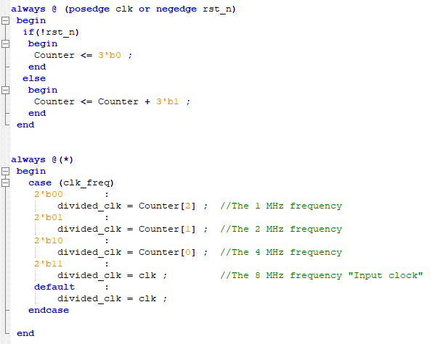
Modules detailed explanation
Clock Divider
Code and Explaination
The code is very simple, just implement a 3 bit counter and a mux.
Assuming Input frequency = 8 MHz
For Input frequency/8 : Choose the MSB of the counter from the mux. “1 MHz”
For Input frequency/4 : Choose the intermediate bit from the mux. “2 MHz”
For Input frequency/2 : Choose the LSB from the mux. “4 MHz”
For Input frequency : Choose the LSB from the mux. “8 MHz”
[2:0]
Please Note : the divided frequencies won’t be used simultaneously in the circuit which made clk divider design easier.

Slide 29
04
Testbench and Test cases

Slide 30
Testbench and Test cases
Methodology
We used in our test case :
$monitor function to track the signals which give indication on the current state of the FSM like “wash_done, fill_water_sig, washing_sig, rinse_sig, spin_sig”
If conditions and also $display function to provide better visualization of the results.
Tasks that make the testbench readable and automated.
We had 3 main test cases : normal wash, double wash and testing of the timer pause signal.
We didn’t perform a test case specified to changing the input frequency as it’s makes sense that the input divided frequency is specified before the runtime, however we explicitly performed the 3 test cases on all choice of the clk_freq[1:0] selection line and all had the same results.
Please note: for lowering the simulation time, we will work with Frequencies in kHz range to verify the functionality
[2:0]

Slide 31
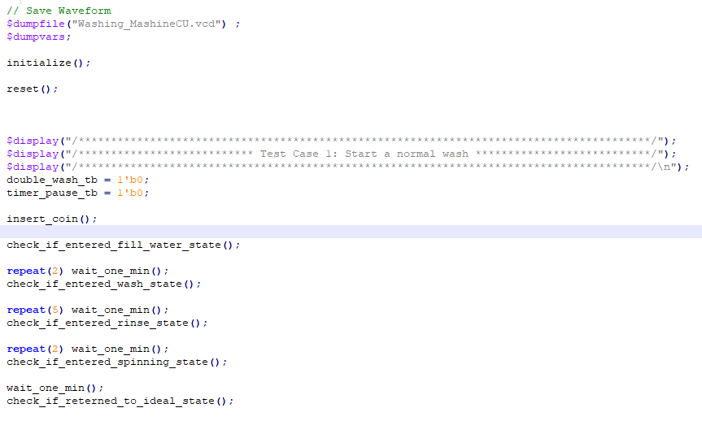
Testbench and Test cases
Test Case 1 : Normal Wash
After initialization of the inputs, and performing reset “using dedicated tasks”, We performed test case 1
We also used the $monitor function to track the previously mentioned signals
[2:0]

Slide 32
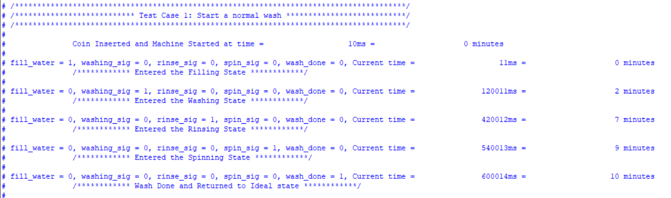
Testbench and Test cases
Test Case 1 : Normal Wash “Results”
The machine entered all states in the desired time and took the desired duration.
So, Test Case 1 is successful
2 mins
5 mins
2 mins
1 min
[2:0]

Slide 33
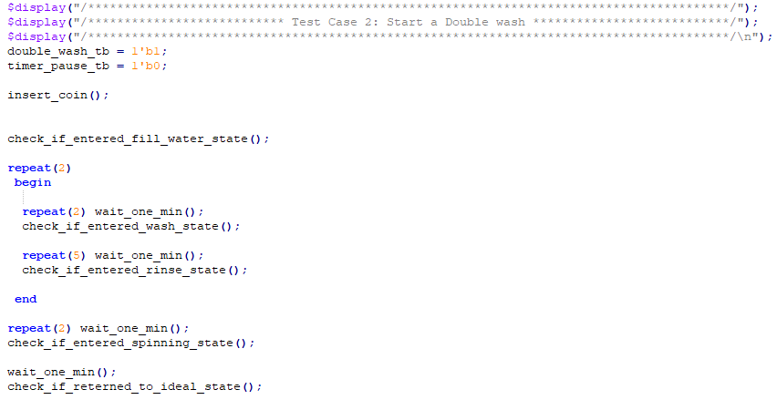
Testbench and Test cases
Test Case 2 : Double Wash
[2:0]

Slide 34
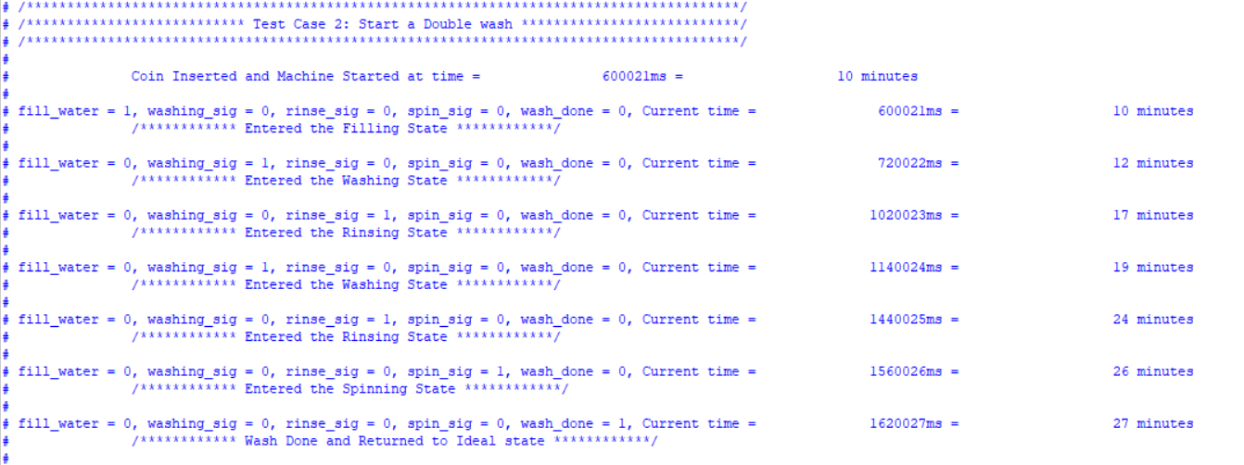
Testbench and Test cases
Test Case 2 : Double Wash “Results”
First wash and rinse
Second wash and rinse
The machine performed successfully two wash rinse cycles
So, Test Case 2 is successful
[2:0]

Slide 35
Testbench and Test cases
Test Case 3 : Testing Timer Pause
Methodology :
We will Assert the timer pause signal from the beginning of the wash and we will test if this signal affects the functionality of the states or pause the timer in states other than spinning state.
So, will test the two thing in all of the states while keeping the timer pause signal asserted, first thing is the functionality “ does asserting the timer_pause signal lowers the signal that’s asserted in its corresponding state like “filling_water signal for ex”, the second thing is testing the timer if paused, and this is done through checking on the FSM by the time it’s supposed to move from one state to another “by checking on the corresponding state signal to know if the FSM moved from a state to another at the time it’s supposed to do so. If it didn’t do that, it indicates that the timer is paused and the FSM is stuck at the old state.
[2:0]

Slide 36
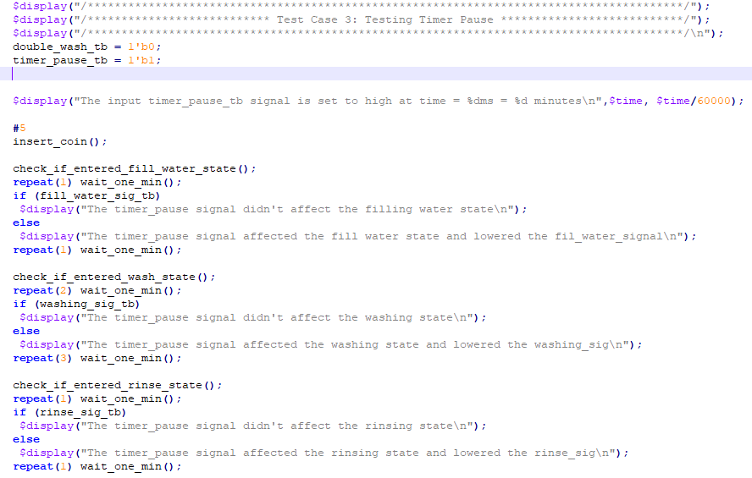
Testbench and Test cases
Test Case 3 : Testing Timer Pause
Part one : testing all the states other than the spinning state
[2:0]

Slide 37
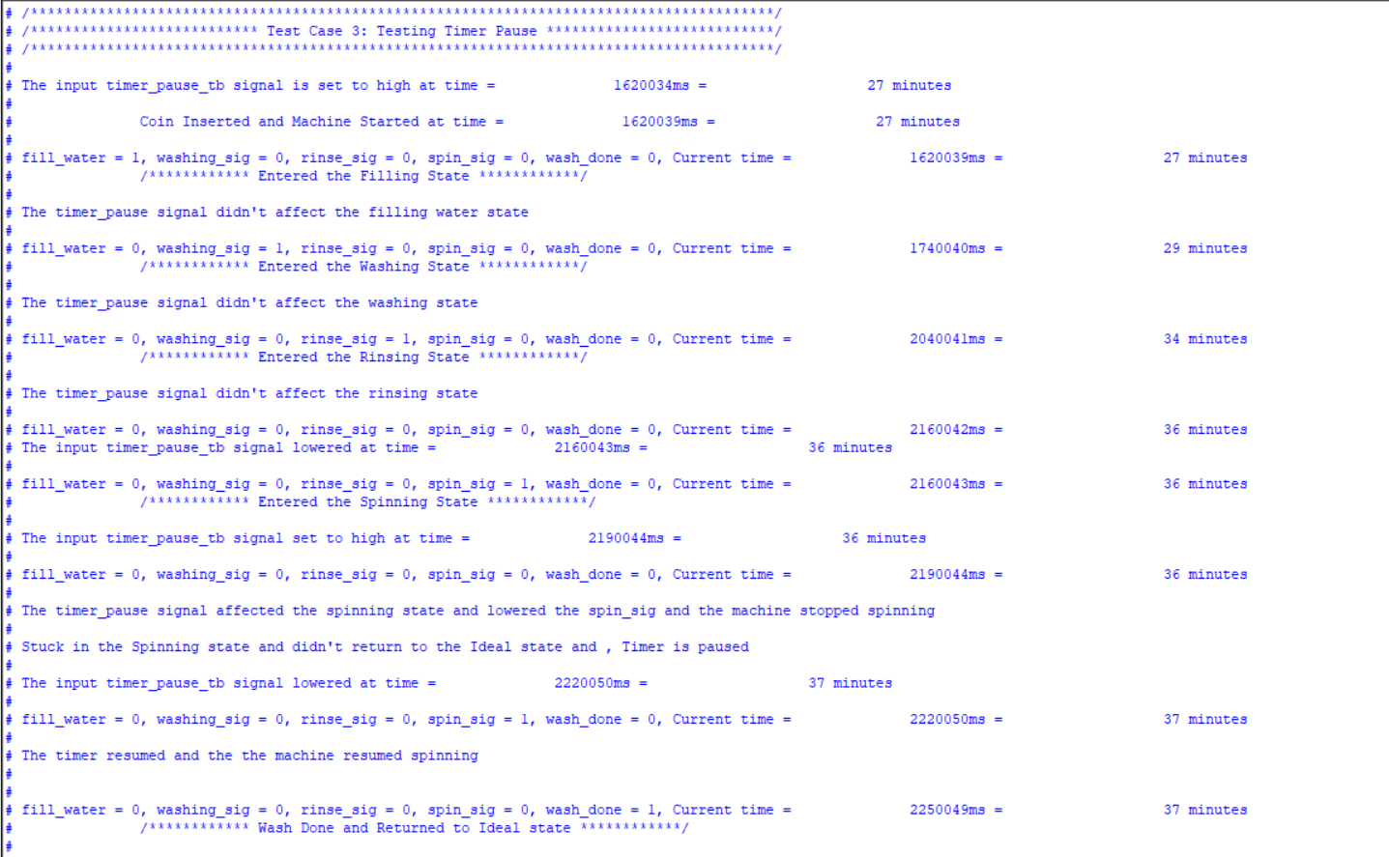
Testbench and Test cases
Test Case 3 : Testing Timer Pause
Part one “results” : testing all the states other than the spinning state
The timer wasn’t paused at any of the states other than the spinning state
The Functionality of the states is affected
[2:0]

Slide 38
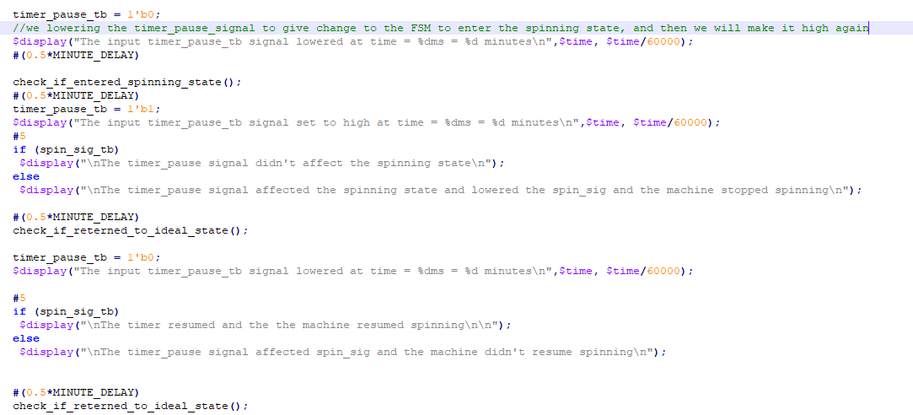
Testbench and Test cases
Test Case 3 : Testing Timer Pause
Part two : focusing on testing the spinning state
“we will lower the timer_pause signal before the FSM enters the spinning state in order to give chance to the FSM to enter the spinning state, and then while the spinning state is active, we will assert the timer_pause and test if the spin_sig becomes low and if the timer pauses.
[2:0]

Slide 39
Testbench and Test cases
Test Case 3 : Testing Timer Pause
Part two : focusing on testing the spinning state
while the spinning state is active, we will assert the timer_pause and test if the spin_sig becomes low and if the timer pauses.
[2:0]

Slide 40
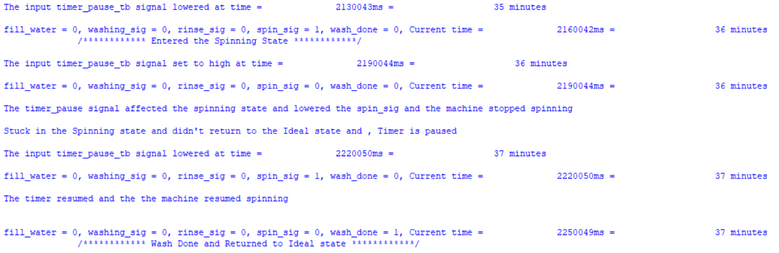
Testbench and Test cases
Test Case 3 : Testing Timer Pause
Part two : focusing on testing the spinning state “Results”
From above : when asserting the timer_pause while the spinning state is active
The spin_signal is lowered (The machine stops spinning)
By the time in which FSM should move from the spinning state and return to the ideal state ”wash_done = 1”, it didn’t do that ”wash_done = 0” which indicates that the timer is actually paused and it’s stuck in spinning state.
[2:0]

Slide 41
Testbench and Test cases
Test Case 3 : Testing Timer Pause
Part two : focusing on testing the spinning state “Results” continued’
From above :
when deasserting the timer_pause while the spinning state is active
The spin_signal is set to high again (The machine resumes spinning)
FSM moved from the spinning state and returned to the ideal state after some time which indicates that the timer is resumed.
[2:0]

Slide 42
Testbench and Test cases
Test Case 3 : Testing Timer Pause Overall results
The Timer Pause signal don’t affect any state or pause the timer in any state other than the spinning state.
When the spinning state is active
when asserting the timer_pause
The spin_signal is lowered (The machine stops spinning)
FSM didn’t move from the spinning state and return to the ideal state at the time it should do so which indicates that the timer is paused.
when deasserting the timer_pause
The spin_signal is set to high (The machine resumes spinning)
FSM moves from the spinning state and returns to the ideal state after some time which indicates that the timer is resumed.
[2:0]

Slide 43
THANKS!
Do you have any questions?
kerellosnashaat@gmail.com

